Slide 1
GW150914, 220 mode ringdown, GR deviation parameter from geometric deviations of final metric
Zaryab Ahmed
University of Stavanger
20/11/23

Slide 2
We are interested in the ringdown of black holes
We like to fit damped sinusoids (QNMs)
Five parameters for each mode: Starting time, amplitude, phase, frequency, damping time
Perturb around a background BH (Kerr, in GR), to find frequency and damping time (2 parameters -> 2 parameters in standard GR)
Starting time, amplitude, phase determined by inspiral

Slide 3
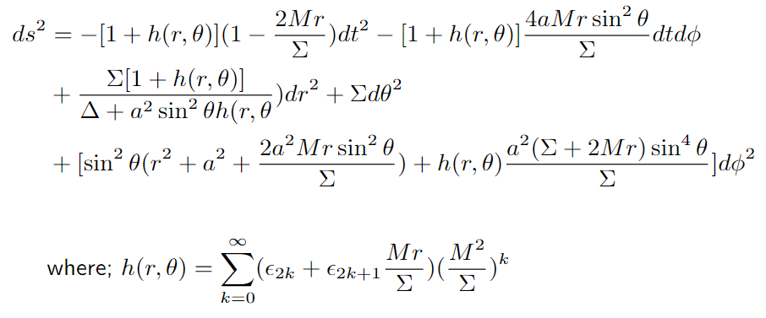
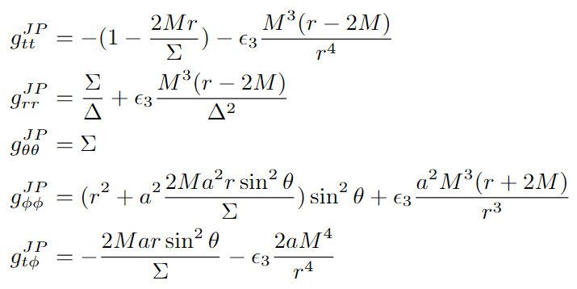
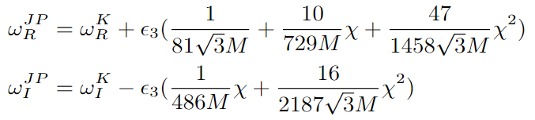
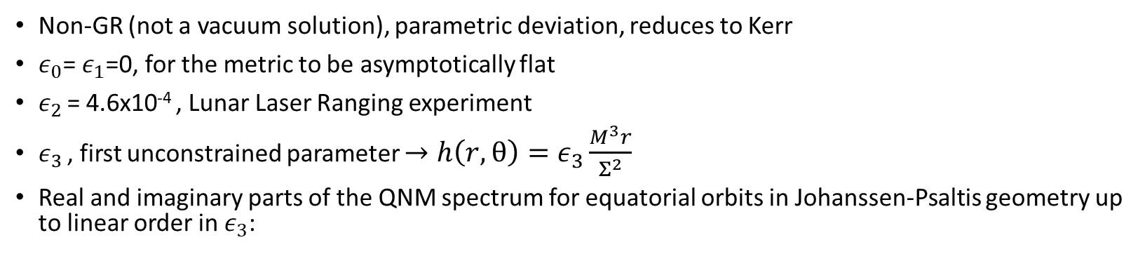
General Stationary, Axisymmetric Metrics have more than 2 parameters
{1}
Non-GR (not a vacuum solution), parametric deviation, reduces to Kerr
$ε_{0}$= $ε_{1}$=0, for the metric to be asymptotically flat
$ε_{2}$ = 4.6x10⁻⁴ , Lunar Laser Ranging experiment
$ε_{3}$ , first unconstrained parameter $→h\left(r,θ\right)=ε_{3}\frac{M^{3}r}{Σ^{2}}$
Real and imaginary parts of the QNM spectrum for equatorial orbits in Johanssen-Psaltis geometry up to linear order in $ε_{3}$:
{2}
{1} A metric for rapidly spinning black holes suitable for strong-field test of the no-hair theorem https://link.aps.org/doi/10.1103/PhysRevD.83.124015
{2} Probing beyond-Kerr spacetimes with inspiral-ringdown corrections to gravitational waves https://link.aps.org/doi/10.1103/PhysRevD.101.084050

Slide 4
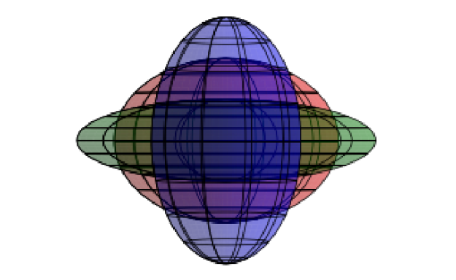


$$ε_{3}=0 \left(Kerr\right)$$
$$ε_{3}>0 \left(JP, Prolate\right)$$
$$ε_{3}<0 \left(JP, Oblate\right)$$
A visual representation of how $ε_{3}$ affects the ergospheres of Kerr and JP spacetimes.

Slide 5
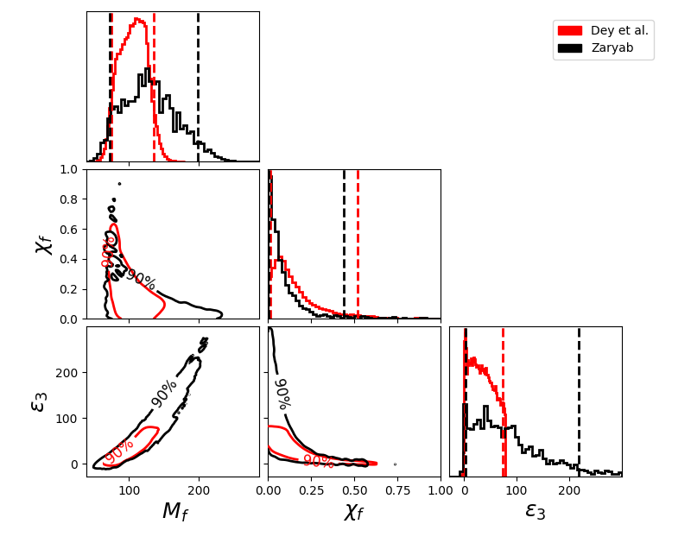
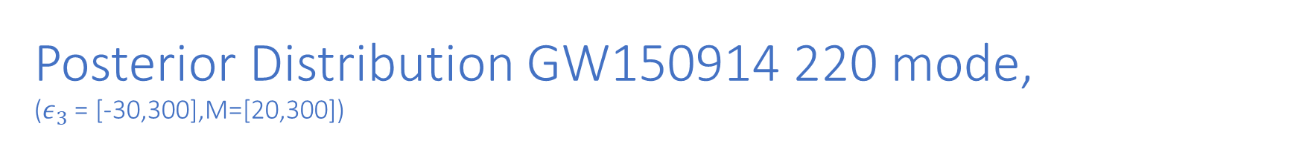
Posterior Distribution GW150914 220 mode, ($ε_{3}$= [-30,300],M=[20,300])
Notes:
Cite Dey et al

Slide 6
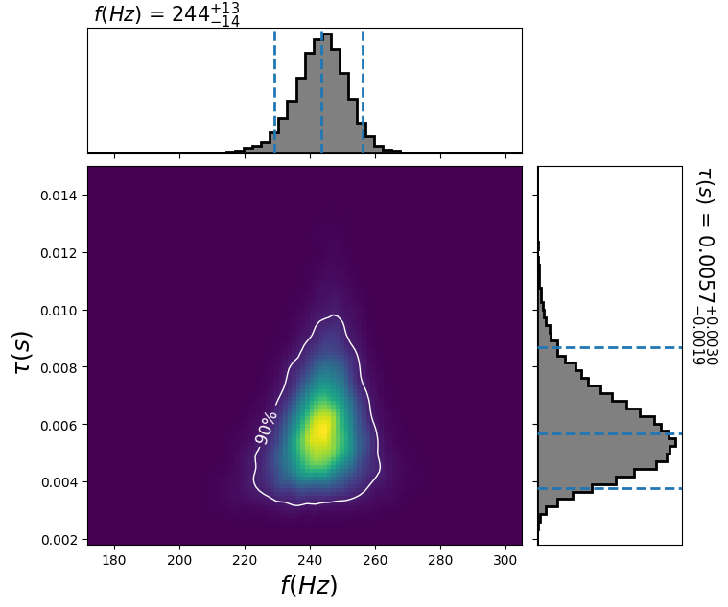
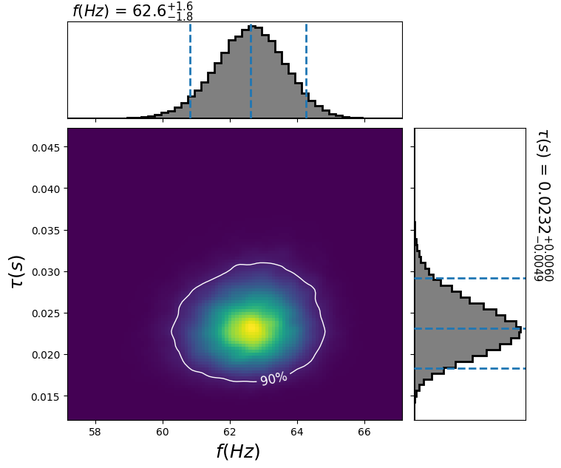


Frequency-Tau Distribution
GW150914
GW190521
$\frac{Δf}{f}=0.053$, $\frac{Δτ}{τ}=0.51$
$\frac{Δf}{f}=0.027$, $\frac{Δτ}{τ}=0.23$

Slide 7
Add 220 GW190521 plot

Slide 8
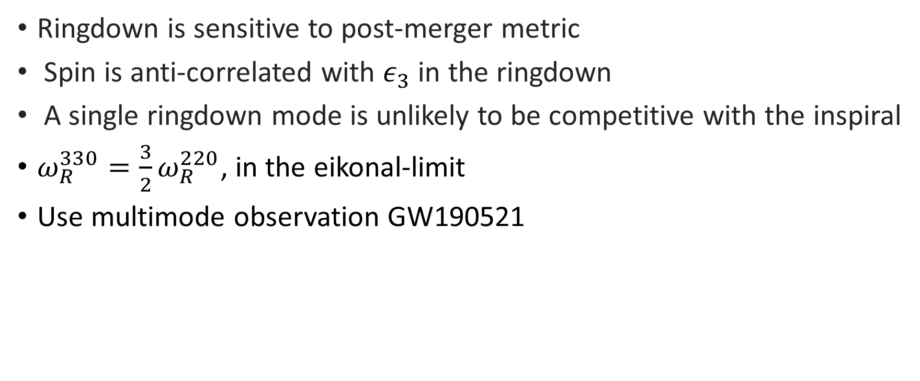
Conclusions
Ringdown is sensitive to post-merger metric
Spin is anti-correlated with $ε_{3}$ in the ringdown
A single ringdown mode is unlikely to be competitive with the inspiral
$ω_{R}^{330}=\frac{3}{2}ω_{R}^{220}$, in the eikonal-limit
Use multimode observation GW190521

Slide 9
THANK YOU!

Slide 10
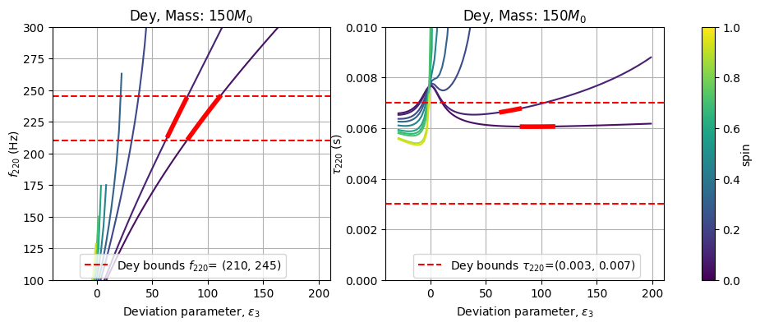
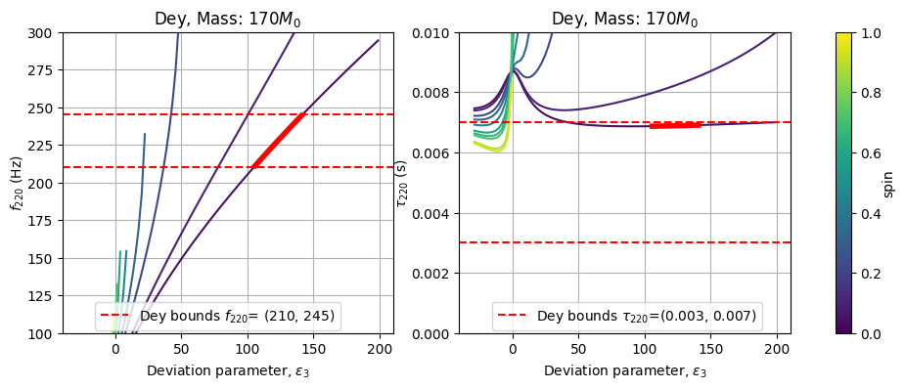
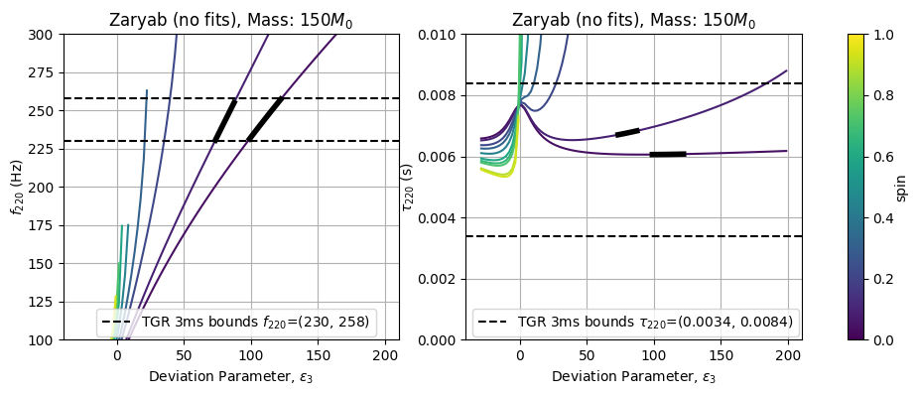
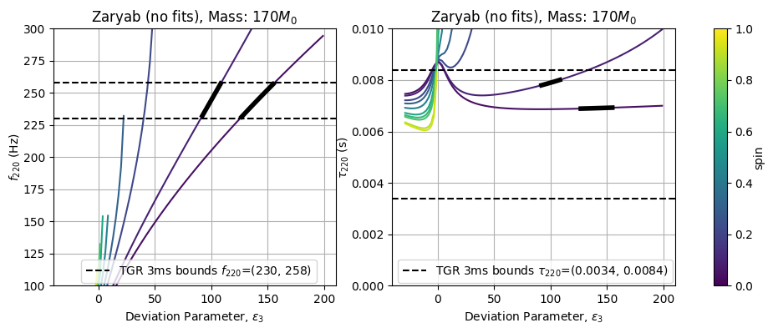
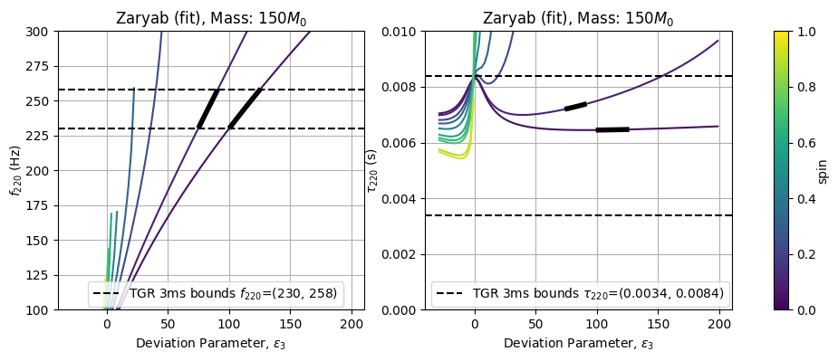
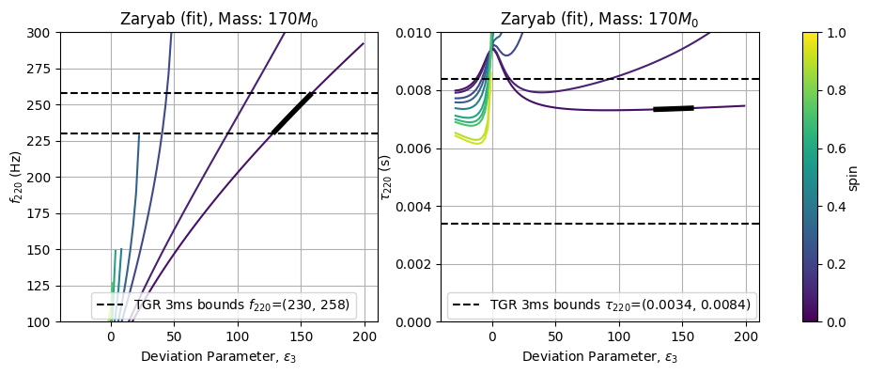

Slide 11
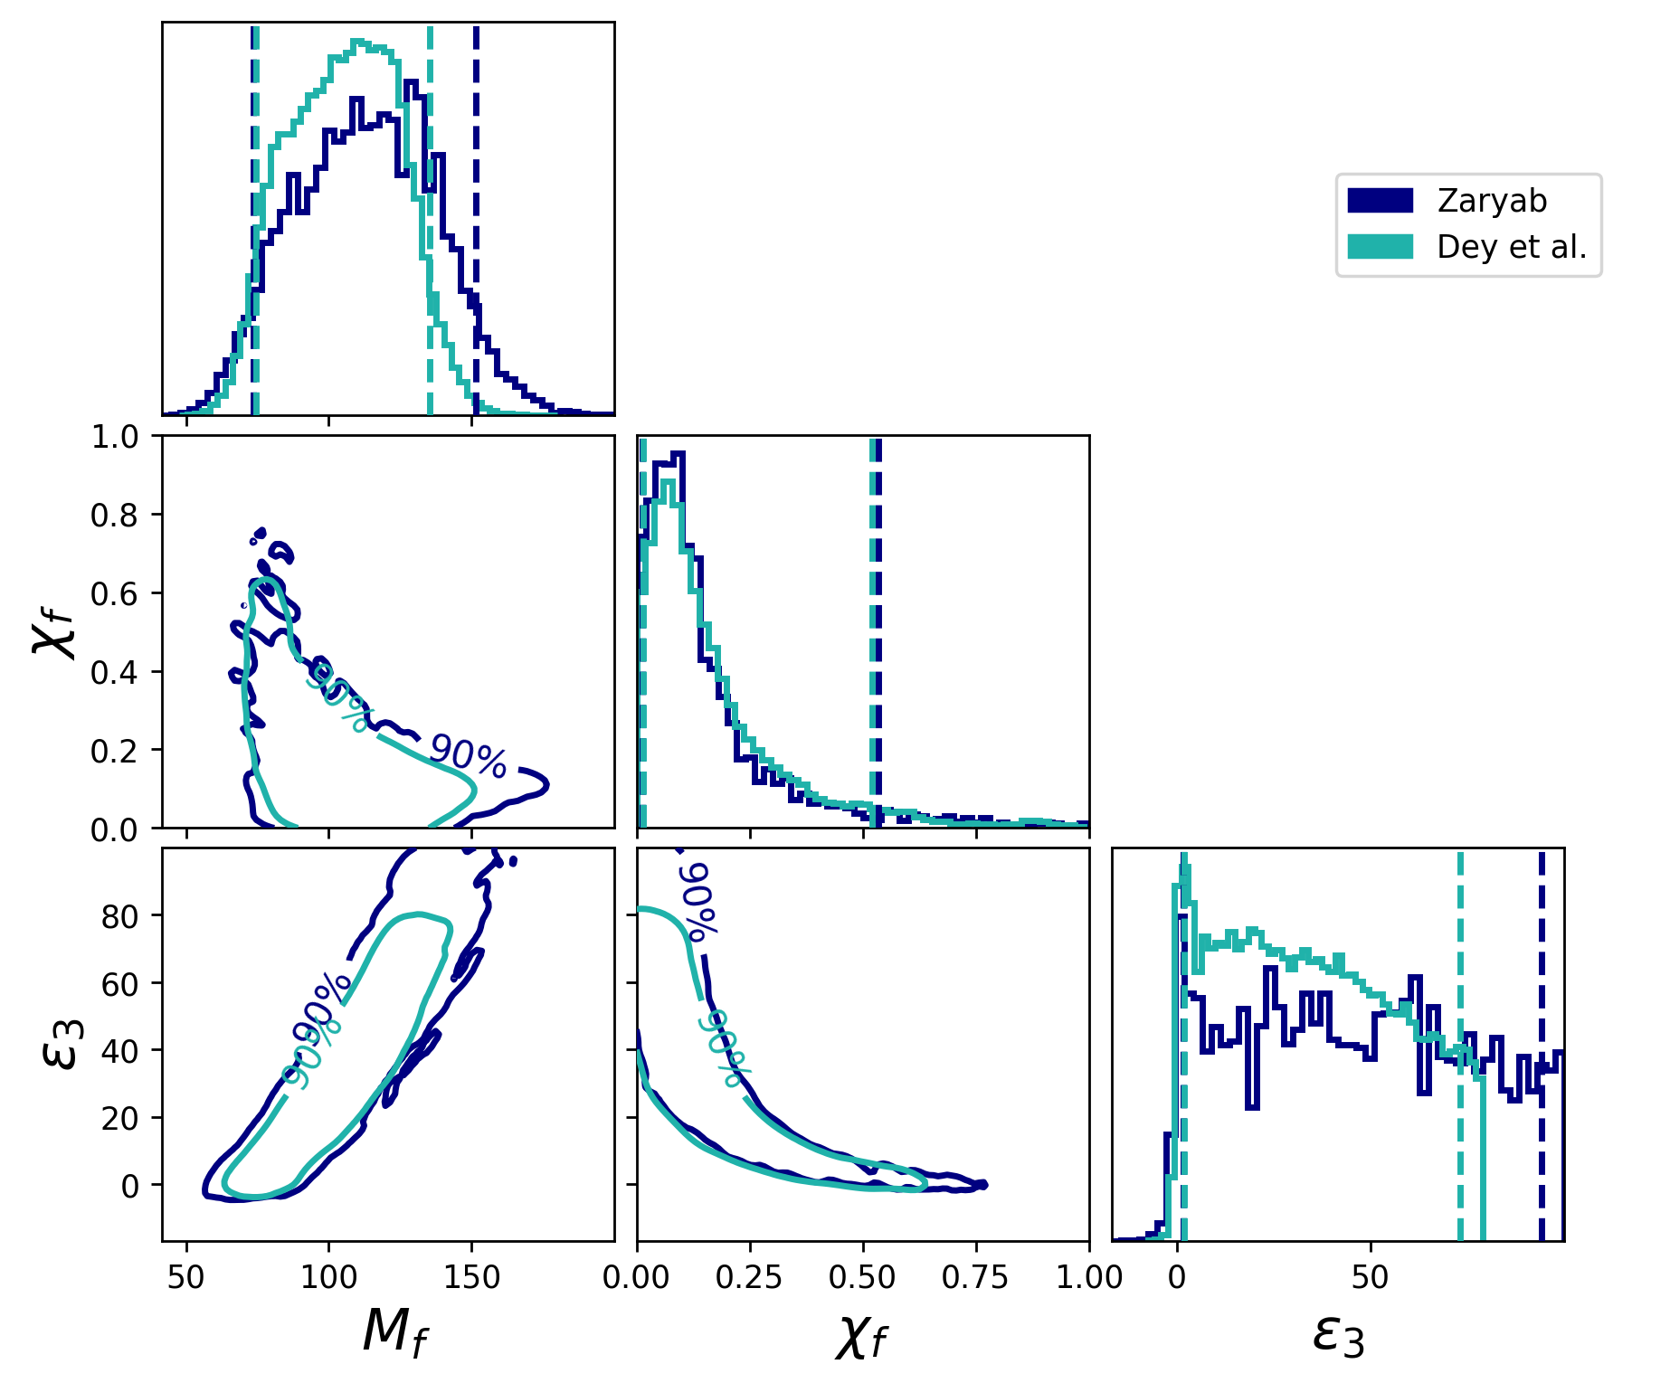

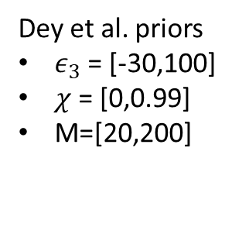
Posterior Distribution GW150914, ($ε_{3}$= [-30,100],M=[20,200])
Dey et al. priors
$ε_{3}$= [-30,100]
$χ$ = [0,0.99]
M=[20,200]

Slide 12
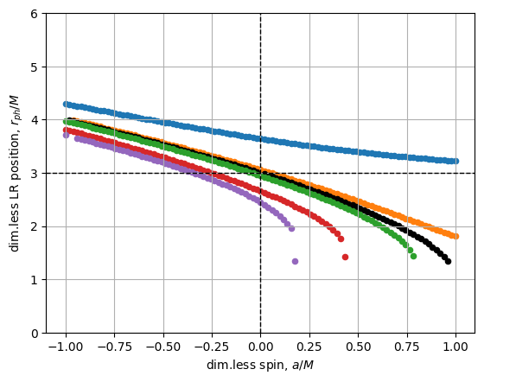
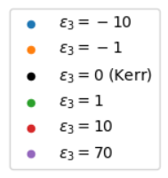
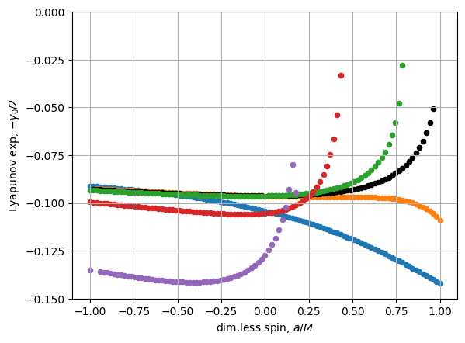
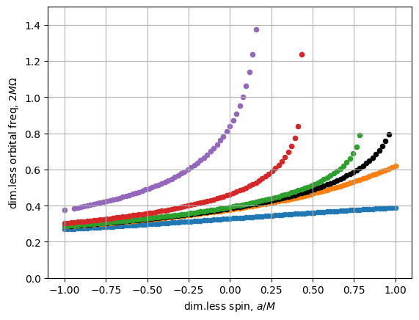

Slide 13

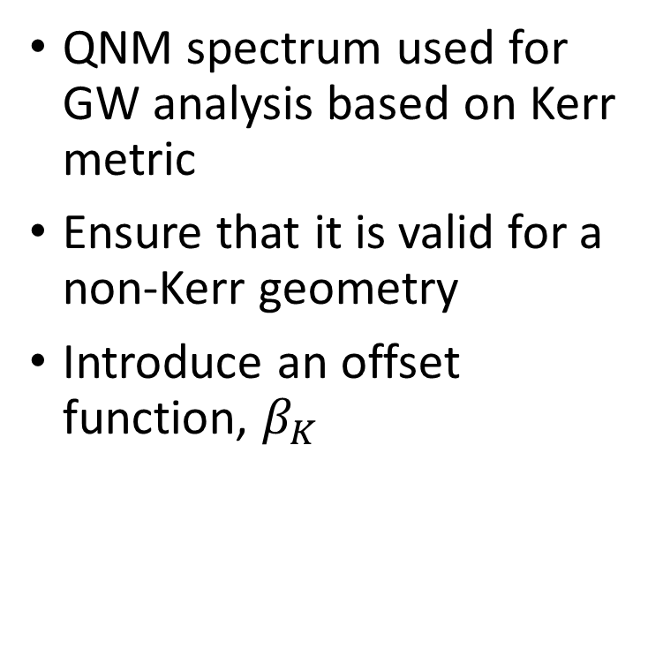
Post-Kerr QNM Validity
{4}
QNM spectrum used for GW analysis based on Kerr metric
Ensure that it is valid for a non-Kerr geometry
Introduce an offset function, $β_{K}$
{4} Post-Kerr black hole spectroscopy https://link.aps.org/doi/10.1103/PhysRevD.96.064054

Slide 14

Post-Kerr QNM Validity
{4}
QNM spectrum used for GW analysis based on Kerr metric
Ensure that it is valid for a non-Kerr geometry
Introduce an offset function, $β_{K}$
{4} Post-Kerr black hole spectroscopy https://link.aps.org/doi/10.1103/PhysRevD.96.064054

Slide 15


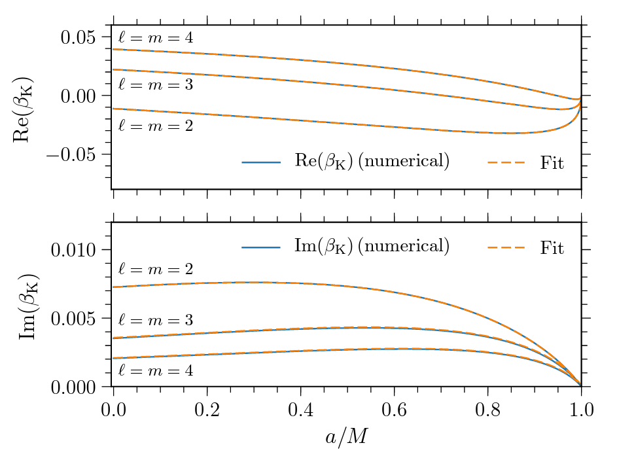
Post-Kerr QNM Validity
{5}
QNM spectrum used for GW analysis based on Kerr metric
Ensure that it is valid for a non-Kerr geometry
Introduce an offset function, $β_{K}$
{5} Post-Kerr black hole spectroscopy https://link.aps.org/doi/10.1103/PhysRevD.96.064054

Slide 16
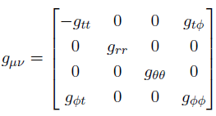




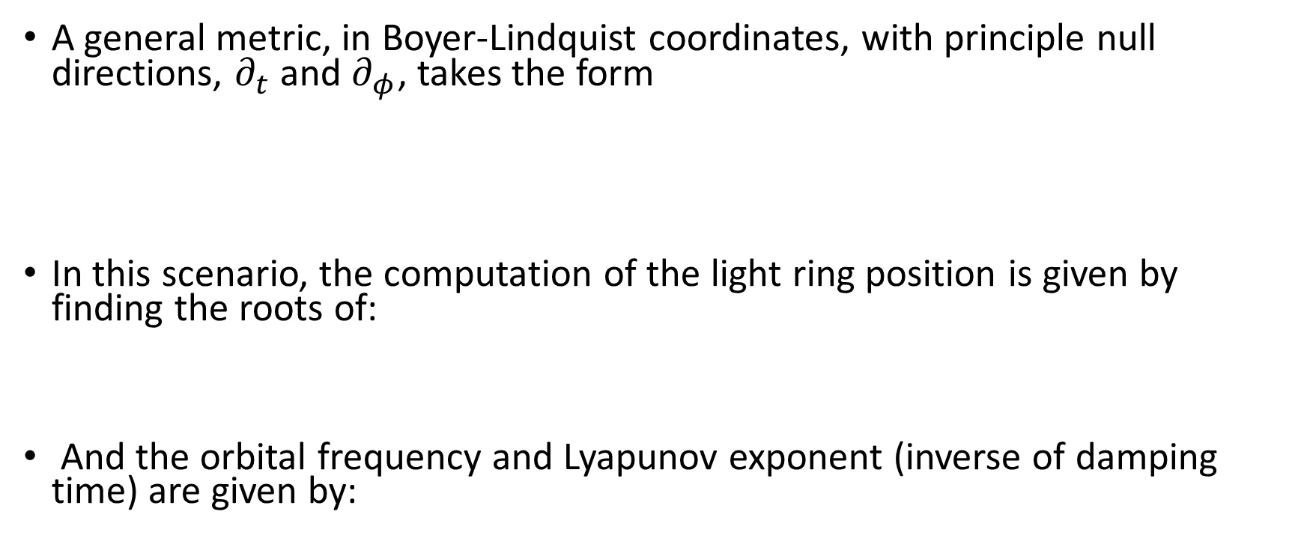
General Stationary, Axisymmetric Metrics have more than 2 parameters
{1}
A general metric, in Boyer-Lindquist coordinates, with principle null directions, $∂_{t}$ and $∂_{φ}$, takes the form
In this scenario, the computation of the light ring position is given by finding the roots of:
And the orbital frequency and Lyapunov exponent (inverse of damping time) are given by:
{1} Post-Kerr black hole spectroscopy https://link.aps.org/doi/10.1103/PhysRevD.96.064054

Slide 17
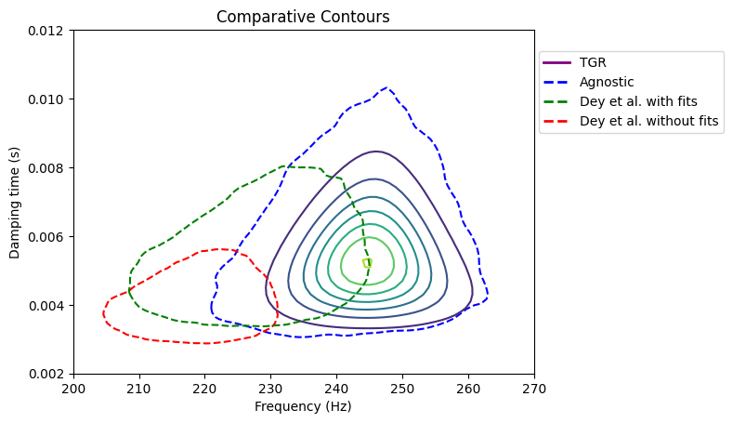
Extras

Slide 18
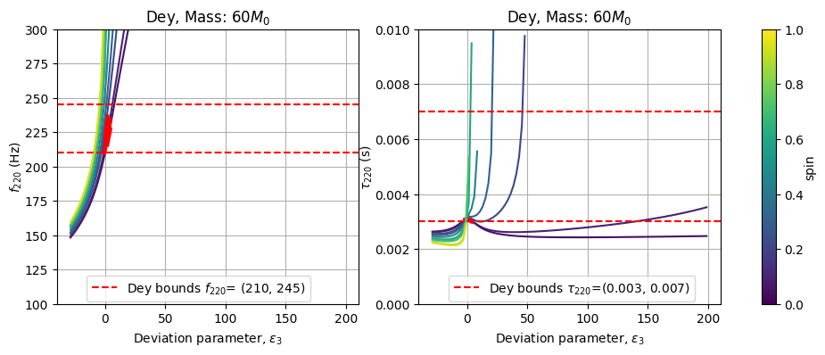
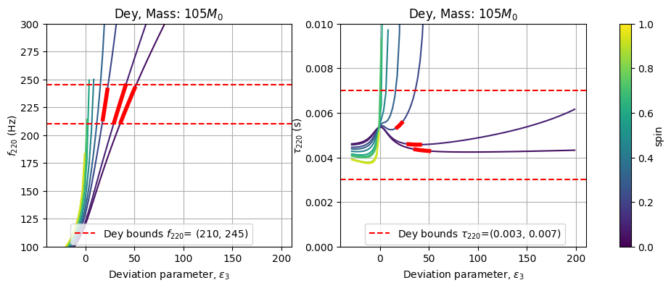
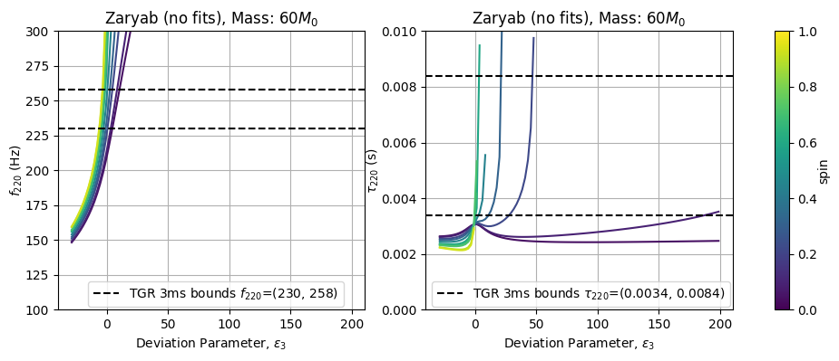
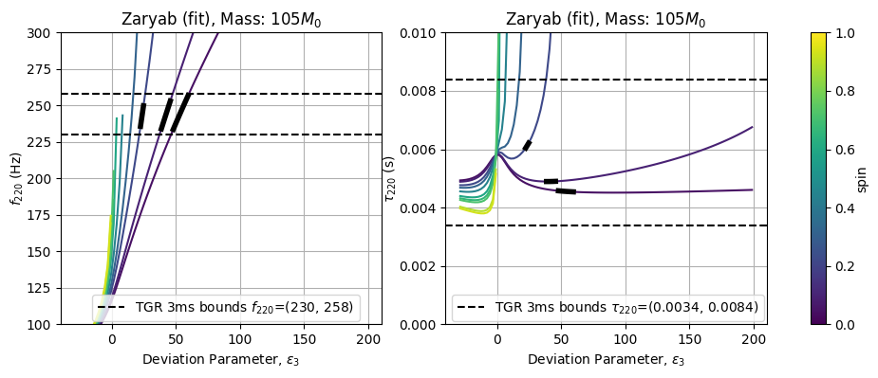
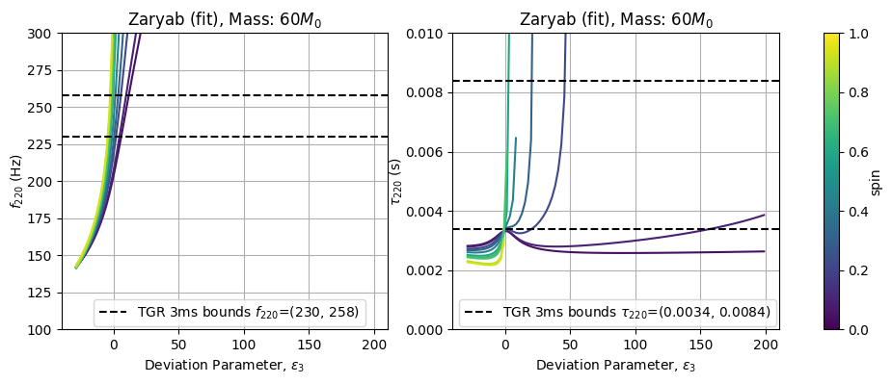
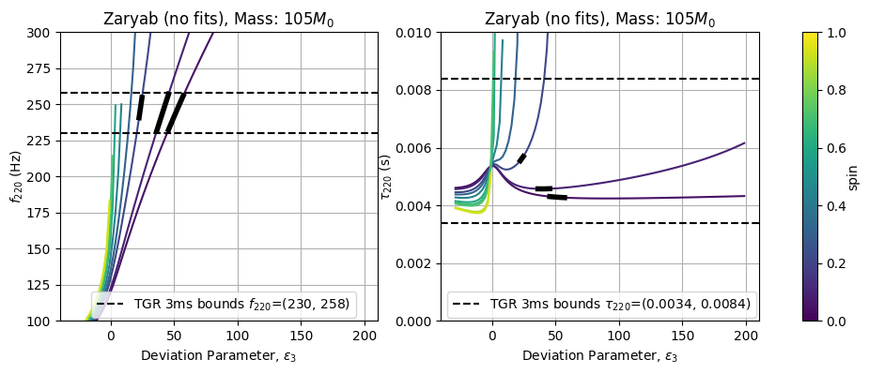

Slide 19
